Slide 1
Aspects in Analysis And Design
Themes and JPDD

Slide 2
Analysis

Slide 3
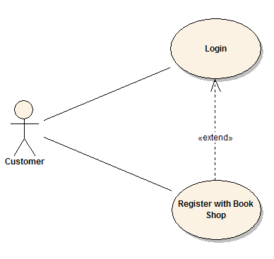
AOSD via Use Cases
Ivar Jacobson - the one who first came with this idea in 2003
Jacobson, I., Ng, P.: Aspect-Oriented Software Development with Use Cases.
Addison Wesley Professional (2004), ISBN 0-321-26888-1.
Use-case modularity problem
Previously unsupported in analytical models and in
implementational environments
EASILY representable with aspect-oriented programming
- solved by AOP programming language
-moved to implementation level
Prebrané z https://sparxsystems.com/images/screenshots/UCLogin.gif

Slide 4
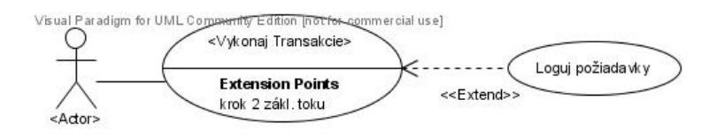
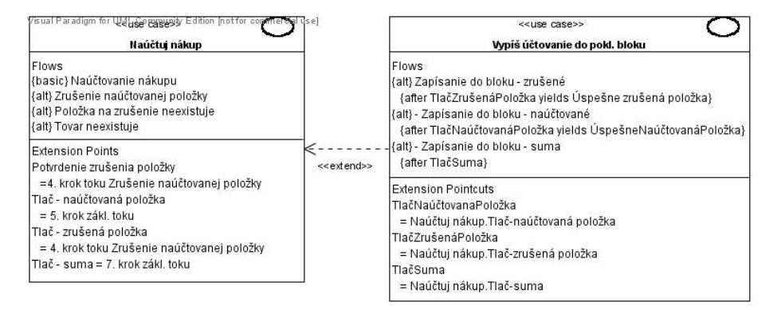
Prebrané z Bc. Pavol Michalco: PRÍPADY POUŽITIA A TÉMY V PRÍSTUPE THEME/DOC

Slide 5
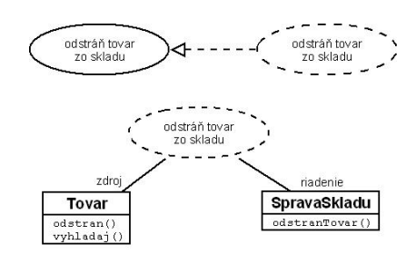
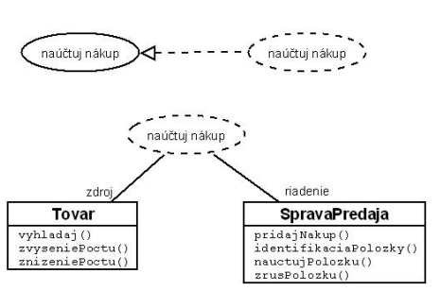
Peer Use Cases
PEER USE CASES: Use cases without binding between each other
-> independent of each other
-> can be processed in paralell
-> have an affect on shared/common entity
Separation of concerns can be problematic in peer/extension use cases
Collaboration diagrams:
Collaboration diagram: Accounting the purchase
Collaboration diagram:
Remove goods from warehouse
Zdroje z Bc. Pavol Michalco: PRÍPADY POUŽITIA A TÉMY V PRÍSTUPE THEME/DOC

Slide 6
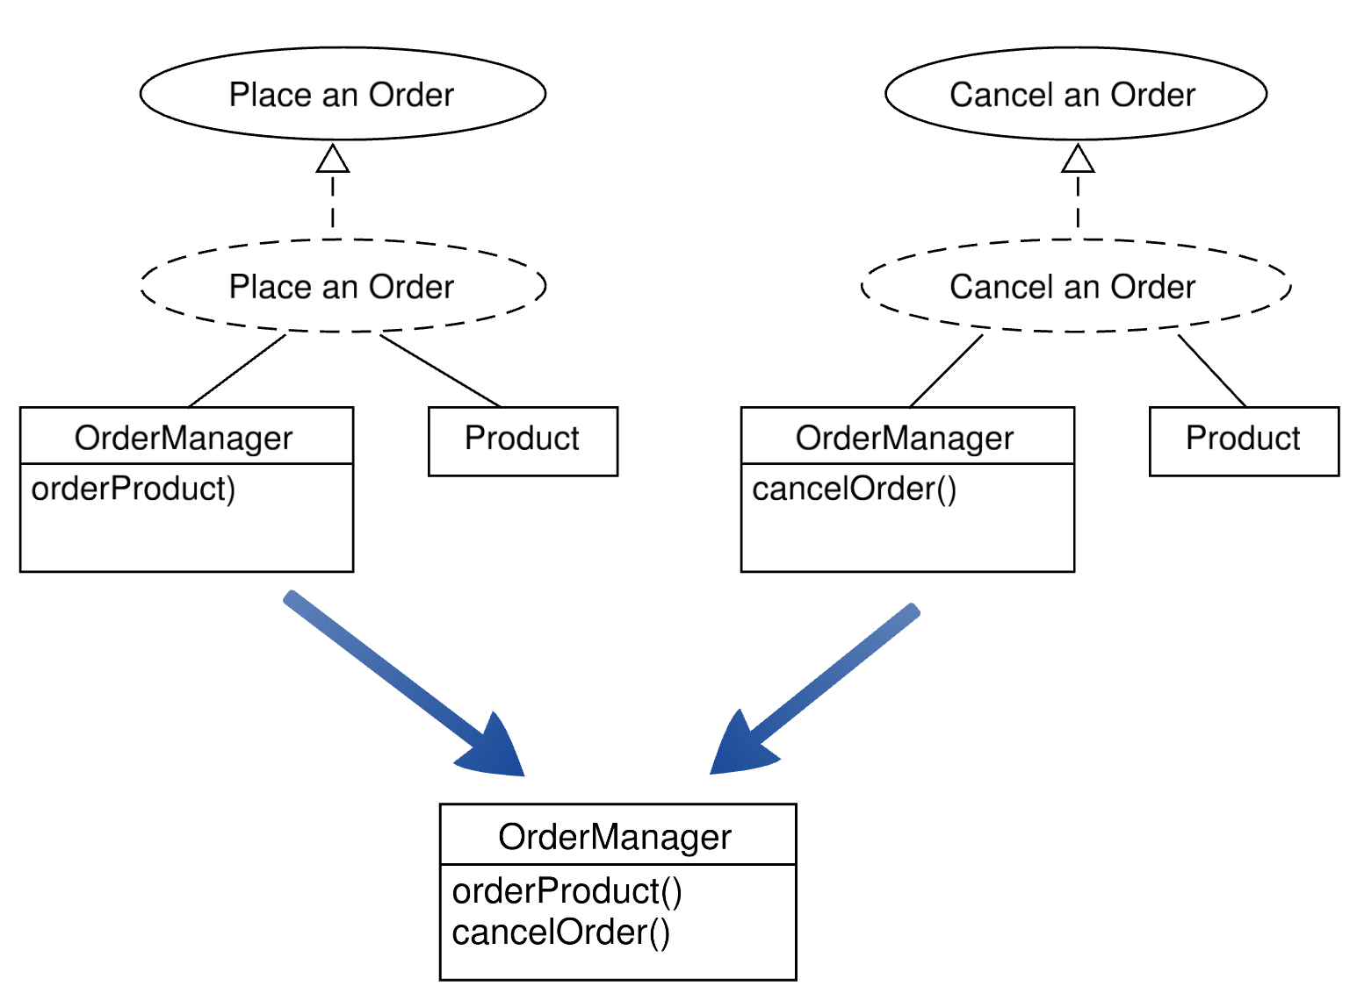

Slide 7
Dynamically extending class
1. Declaring class
Prototype-based programming
class VerticePair {
  constructor(x, y) {
    this.x = x;
    this.y = y;
  }
  getX() { return this.x; }
  getY() { return this.y; }
}
2. Instantiating class
var verticePair = new VerticePair(5, 6);
var newX = verticePair.x;
console.log(newX); //newX //(or) //to prints newX
3. Extending class dynamically
-possibly with new features… that can be then evolved independently
VerticePair.prototype.checkPoint = function() { if (this.x > 2) { throw new Error('Coordinate X is greater!');} }
4. Using the extension
verticePair.checkPoint();

Slide 8
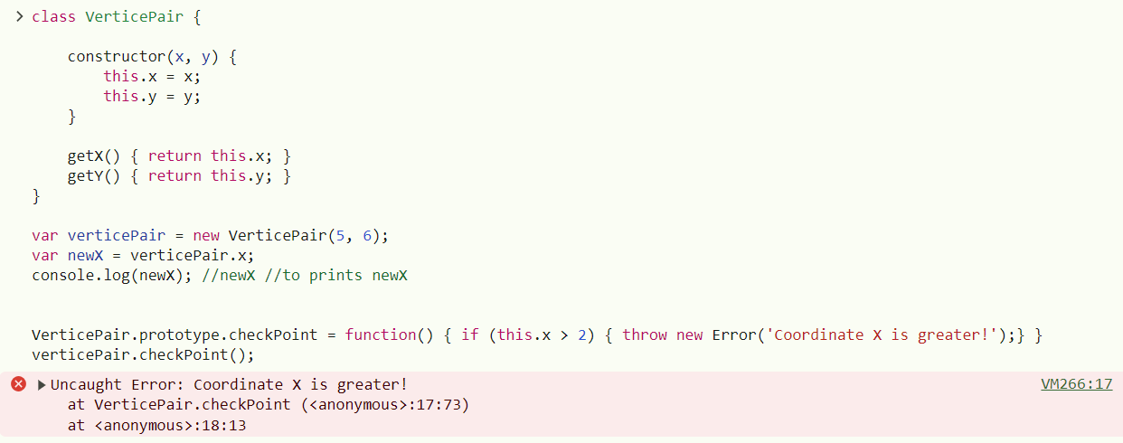
Test

Slide 9
Dynamically extending object
1. Declaring class
Dynamic Object Modification
2. Instantiating class
class VerticePair {
  constructor(x, y) {
    this.x = x;
    this.y = y;
  }
  getX() { return this.x; }
  getY() { return this.y; }
}
var verticePair = new VerticePair(5, 6);
var newX = verticePair.x;
console.log(newX); //newX //(or) //to print newX
var verticePair0 = new VerticePair(1, 6);
3. Extending class dynamically
-possibly with new features… that can be then evolved independently
verticePair.checkPoint = function() { if (this.x > 2) { throw new Error('Coordinate X is greater!');} }
4. Using the extension
verticePair0.checkPoint();
Is it successfull? Is extension bound to particular object?
verticePair.checkPoint();

Slide 10
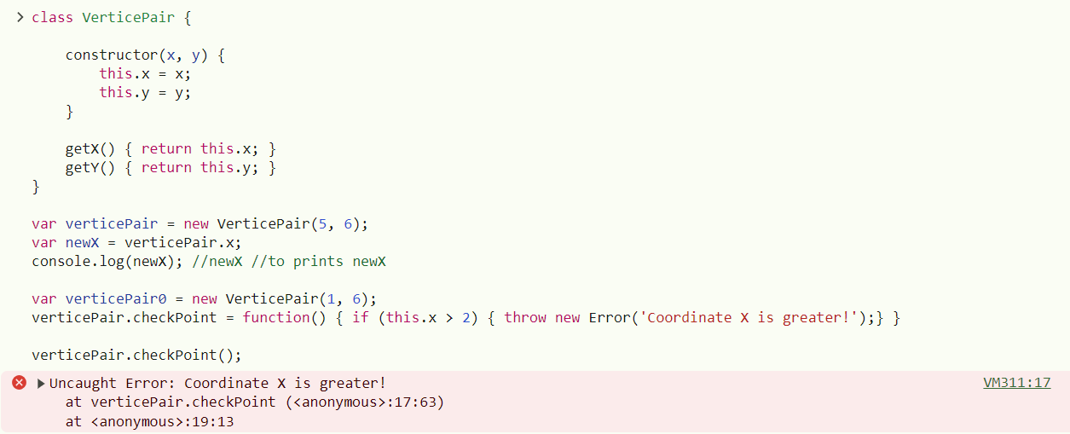
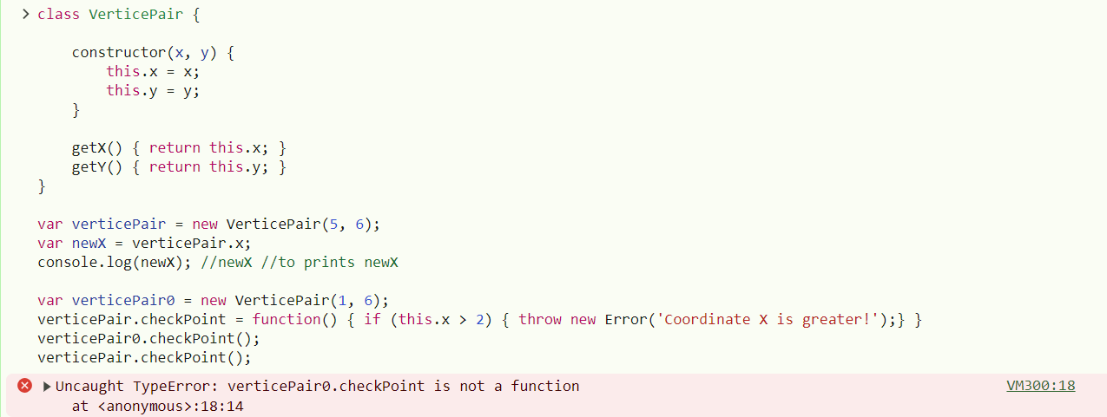
Test

Slide 11
Peer Use Cases
PEER USE CASES: Use cases without binding between each other
-> independent of each other
-> can be processed in paralell
-> have an affect on shared/common entity
Separation of concerns can be problematic in peer/extension use cases
Collaboration diagrams:
Collaboration diagram: Accounting the purchase
Collaboration diagram:
Remove goods from warehouse
Zdroje z Bc. Pavol Michalco: PRÍPADY POUŽITIA A TÉMY V PRÍSTUPE THEME/DOC

Slide 12
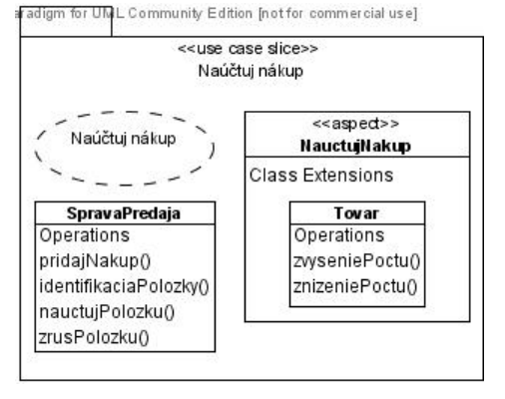
Solution to Peer Use Cases: Intertype Declaration
-we create use case slice…
…containing only specifics for this
use case (Accounting the
` purchase in Figure)
Zdroje z Bc. Pavol Michalco: PRÍPADY POUŽITIA A TÉMY V PRÍSTUPE THEME/DOC

Slide 13
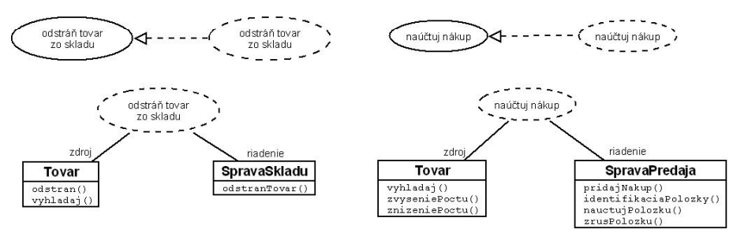
Overlapping Problem in Peer Use Cases
The functionality in form of vyhladaj() method is overlapping:
Sources from: Bc. Pavol Michalco: PRÍPADY POUŽITIA A TÉMY V PRÍSTUPE THEME/DOC

Slide 14
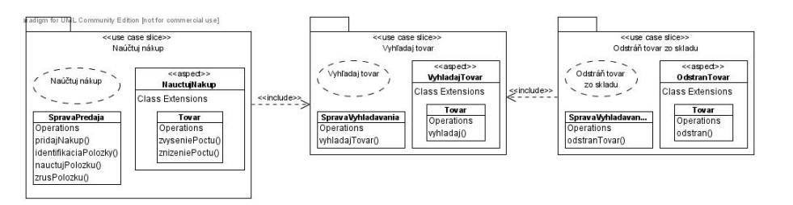
Solving Overlapping Problem in Peer Use Cases
1. New use-case slice with handling of overlapping behaviour:
-this use case slice is connected with <<include>>
2. Handling/defining in superior use case:
3. New non use-case slice with handling of overlapping behaviour:
<<include binding between use case slices
Source from: Bc. Pavol Michalco: PRÍPADY POUŽITIA A TÉMY V PRÍSTUPE THEME/DOC

Slide 15
2. Handling/defining in superior use case:
3. New non use-case slice with handling of overlapping behaviour:
NON USE CASE: domain representative
-provides access in one place to classes that are shared with many use case slices
-not containing aspects at all

Slide 16
Identifying the execution place of the extension of operation
Necessary information
STRUCTURAL CONTEXT
BEHAVIORAL CONTEXT
-position of the extension of
operation in designed structure
(package, class,…)
-point in execution flow where extension
operation will extend the existing operation
->called extension
points in USE CASES
->called join
points in AOP
call Pokladna.zrusPol()
execution Pokladna.zrusPol()
Pri vykonaní
zrusPol() metódy triedy Pokladna

Slide 17
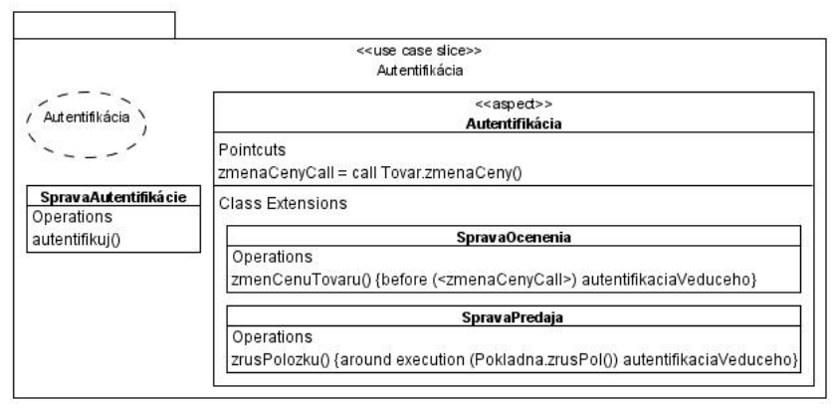
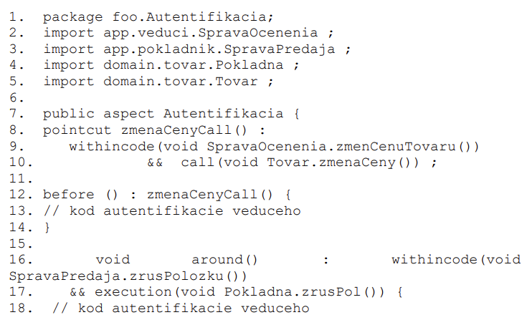

Aspects And
Use Cases
... Example ...
Source from: Bc. Pavol Michalco: PRÍPADY POUŽITIA A TÉMY V PRÍSTUPE THEME/DOC

Slide 18
Details
OVERCOME PARAMETER
CAN BE ALSO DEFINED IN INHERITED ASPECTS SEPARATELY

Slide 19
Themes in Analysis
Theme/Doc
Themes in documentation (Theme/Doc), aspect-oriented analysis
Do not identify themes for us
Serves to identify and clarification in requirements of:
  basic and crosscutting (aspect) themes [IDENTIFICATION OF ASPECTS IN REQUIREMENTS]
  Relations between basic and crosscutting themes
To visualize relations between themes and requirements in following views:
1. VIEW OF THEMES
AND RELATIONS
2. CROSSCUTTING
THEMES VIEW
3. INDIVIDUAL
VIEW

Slide 20
Operations With Themes According to Requirements
Adding themes
Removing themes
Splitting themes
Aggregating themes
Postponing the requirements
Associating with the requirements
Associating/Connecting with the theme

Slide 21
Processes Ongoing in Themes
Processes run in
this order
1. Deciding about themes
2. Observing responsibility of themes
3. Planning of a design
Not strictly
separated

Slide 22
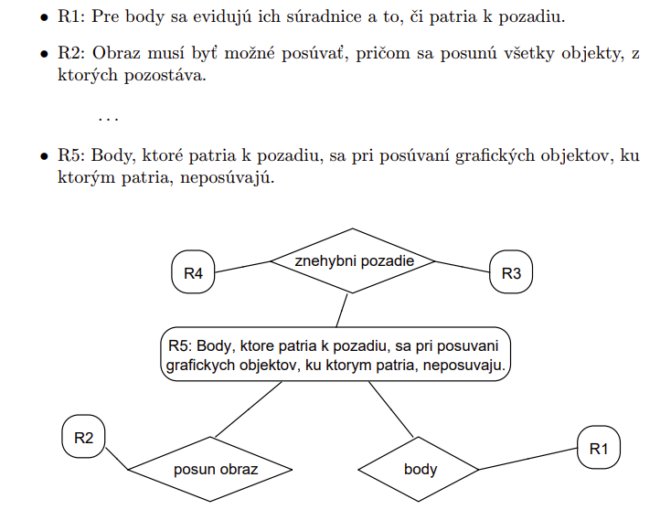
1. Deciding About Themes
Identification of themes in requirements
  How themes are connected (traced) with
  related (for particular theme) requirements
Operating on themes and relations between them
Theme
Requirement
Displayed as rhombus
EDGES
- Connects only related themes with related requirements
- in basic view are only associations
Displayed as rectangle with rounded edges
SHARED REQUIREMENTS
- If connected with multiple themes
GRAPH
ORPHANED REQUIREMENTS
- If connected with no theme

Slide 23
1. Deciding About Themes - Steps
Iterative approach
1. Determining initialization themes:
a) usually from use cases – each use case is usually one initialization theme
b) from requirements
Siobhàn Clarke and Elisa Baniassad. 2005. Aspect-Oriented Analysis
and Design. Addison-Wesley Professional.
1. Identification of key functionalities in requirements and treating them as themes
-if themes are not coherent then will be further decomposed (split)
2. Identification of all verbs in requirements and treating them as themes
-themes have to be aggregated / generalized
-possibility to solve automatically with program
3. Combination of previous two cases
-requirements are searched for signs of features, behaviour or concerns

Slide 24
Examples of
Basic Diagrams of Themes
Source: Aspekty v analýze a návrhu
– prístupy Theme a JPDD Poznámky k
prednáškam z predmetu
Aspektovo-orientovaný vývoja
softvéru, Valentino Vranić, 2017

Slide 25
2. Decomposing/splitting themes that are too general
-especially in cases where the same theme is used for different things
such as in case of object removal that is split into:
erasing the drawn image or moving puzzle away to the drawer
3. Aggregating themes to simplify the graph (improve comprehension)
-from selected two or more themes we create new one in overview of themes with
relations between them and in crosscutting view
-in individual view aggregated/grouped themes are displayed separately
4. Merging similar themes (themes which have the same purpose)
-mostly its caused due to synonyms that are extracted from requirements
Etc. same purpose: Register item to canvas, bind item to canvas
Etc. synonyms: change, modify
5. Deleting irrelevant themes (not characteristic for system)

Slide 26
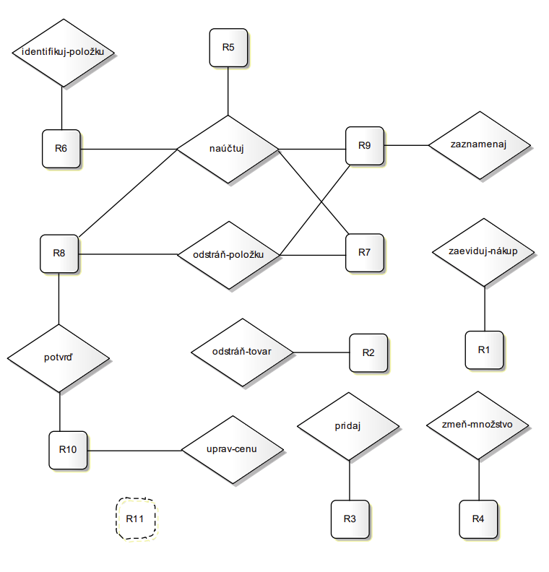
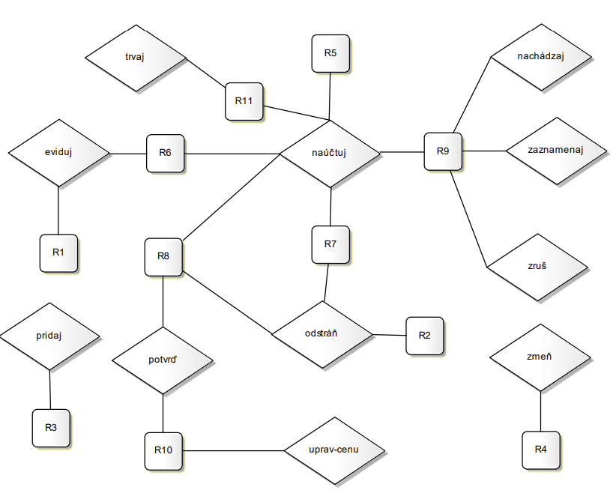
Applying the Changes in Basic Themes View
Source from: Bc. Pavol Michalco: PRÍPADY POUŽITIA A TÉMY V PRÍSTUPE THEME/DOC
*we do not want to treat R11 requirement,
left for next development phases

Slide 27
Identifying Themes - Applying the
Changes in Basic Themes View
Source from: Bc. Pavol Michalco: PRÍPADY POUŽITIA A TÉMY V PRÍSTUPE THEME/DOC
*we do not want to treat R11 requirement,
left for next development phases

Slide 28
Splitting themes - Applying the
Changes in Basic Themes View
Source from: Bc. Pavol Michalco: PRÍPADY POUŽITIA A TÉMY V PRÍSTUPE THEME/DOC
*we do not want to treat R11 requirement,
left for next development phases

Slide 29
Splitting Themes - Applying the
Changes in Basic Themes View
Source from: Bc. Pavol Michalco: PRÍPADY POUŽITIA A TÉMY V PRÍSTUPE THEME/DOC
*we do not want to treat R11 requirement,
left for next development phases

Slide 30
Aggregating Themes - Applying the
Changes in Basic Themes View
Source from: Bc. Pavol Michalco: PRÍPADY POUŽITIA A TÉMY V PRÍSTUPE THEME/DOC
*we do not want to treat R11 requirement,
left for next development phases

Slide 31
Merging Similar Themes - Applying the
Changes in Basic Themes View
Source from: Bc. Pavol Michalco: PRÍPADY POUŽITIA A TÉMY V PRÍSTUPE THEME/DOC
*we do not want to treat R11 requirement,
left for next development phases

Slide 32
Deleting Irrelevant Themes –
Applying the Changes in Basic Themes
View
Source from: Bc. Pavol Michalco: PRÍPADY POUŽITIA A TÉMY V PRÍSTUPE THEME/DOC
*we do not want to treat R11 requirement,
left for next development phases

Slide 33
Observing Responsibility of Themes
Identification of crosscutting themes
The content of one functionality which description crosscuts the description of another functionality in particular requirement
Aspect is a theme which description in requirement
specification crosscuts another theme
Crosscutting place: requirements connected with more than one theme.
The need to find dominant theme for particular requirement
-this theme is aspect theme
in coverage of the requirement amongst all themes
Highlighting of Croscutting behaviour: with oriented connection.

Slide 34
Identification of Crosscutting Themes
Siobhàn Clarke and Elisa Baniassad. 2005. Aspect-Oriented Analysis
and Design. Addison-Wesley Professional.
All of following rules must hold:
Cannot decompose requirement to isolate
its relation with other themes
1. Cannot decompose particular requirement to isolate themes and prevent sharing
2. Candidate theme is selected according to the dominance in coverage of the requirement amongst all themes (because it crosscuts them)
  Checking of requirements if particular theme has information about its behaviour
  (for example authorization: particular business functionality should not have information if rights are verified)
  From DOMINANT theme we create directed connections to other
3. Base theme activates aspect
  the behaviour of aspect is activated with behaviour in base theme
4. Activated and dominant theme is externally activated in multiple situations
  The need to have multiple situations to beneficially apply aspects

Slide 35
Examples of Basic Diagrams of Themes
Cannot decompose particular
requirement to isolate themes
and prevent sharing
R5 Cannot be decomposed
Source: Aspekty v analýze a návrhu
– prístupy Theme a JPDD Poznámky k
prednáškam z predmetu
Aspektovo-orientovaný vývoja
softvéru, Valentino Vranić, 2017

Slide 36
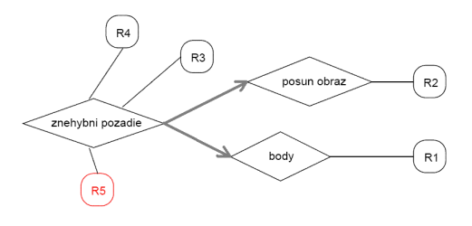
Examples of
Crosscutting
View
2. Candidate theme is selected according
to the dominance in coverage of
the requirement amongst all themes
Checking of requirements if particular
theme has information about its behaviour
4. Activated and dominant theme is
externally activated in multiple situations
Source: Aspekty v analýze a návrhu
– prístupy Theme a JPDD Poznámky k
prednáškam z predmetu Aspektovo-orientovaný vývoja
softvéru, Valentino Vranić, 2017
-------- Information about behaviour ------
3. Base theme activates aspect

Slide 37
Examples of Crosscutting View
Source: Aspekty v analýze a návrhu
– prístupy Theme a JPDD Poznámky k
prednáškam z predmetu
Aspektovo-orientovaný vývoja
softvéru, Valentino Vranić, 2017
Oriented connections between dominant theme and affected ones
The requirement that cannot be split/ remained shared
[All such requirement associated with more then one theme are identified]

Slide 38
Examples of crosscutting view

Slide 39
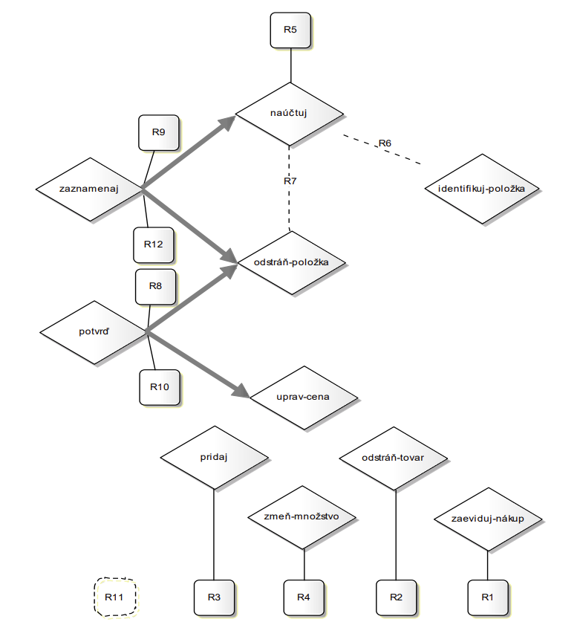
Source from: Bc. Pavol Michalco: PRÍPADY POUŽITIA
A TÉMY V PRÍSTUPE THEME/DOC

Slide 40
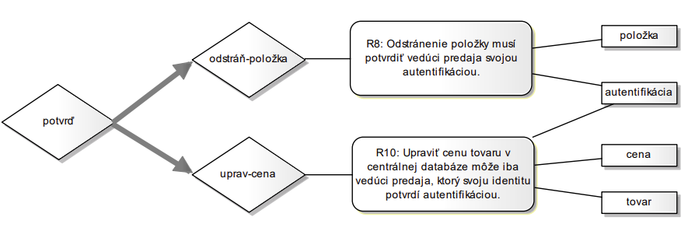
Individual View
Created in the end of analysis as preparation for design
Overview of crosscutting themes for exactly one particular theme
Contains:
  related requirements
  identified entities
  Individual views on related themes (in case of crosscutting view)
Source from: Bc. Pavol Michalco: PRÍPADY POUŽITIA A TÉMY V PRÍSTUPE THEME/DOC

Slide 41
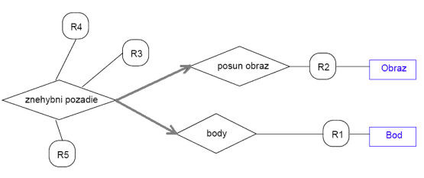
Example of Individual View
related requirements
Source: Aspekty v analýze a návrhu
– prístupy Theme a JPDD Poznámky k prednáškam z predmetu
Aspektovo-orientovaný vývoja softvéru, Valentino Vranić, 2017
Individual views on
related themes
(in case of crosscutting view)
  identified entities

Slide 42
Design

Slide 43
Themes in Design
Theme/Uml
As extension to Uml, similarly used primarily in design
For symmetric/asymmetric orientation
Programming language independent
Crosscutting views are captured via parametrized packages (temple packages)

Slide 44
Principles
Kind of themes
Theme
Each theme models one view on system
Expressed with packages
Basic
Crosscutting
Packages
Composition of themes
Specifies:
  The behaviour (UML sequence diagram)
  The structure (UML class diagram)
Contains multiple views

Slide 45
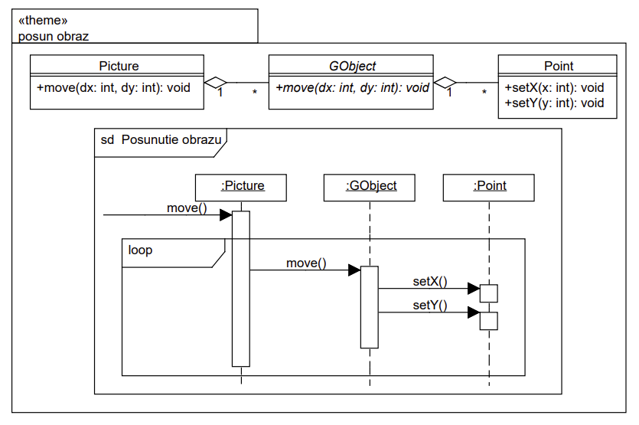
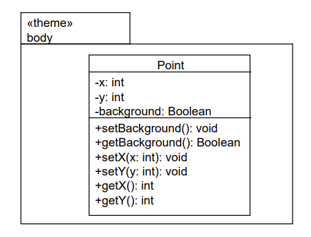
Examples of basic view
Static part - structure
Source: Aspekty v analýze a návrhu
– prístupy Theme a JPDD Poznámky k
prednáškam z predmetu
Aspektovo-orientovaný vývoja
softvéru, Valentino Vranić, 2017
Dynamic part - behaviour

Slide 46
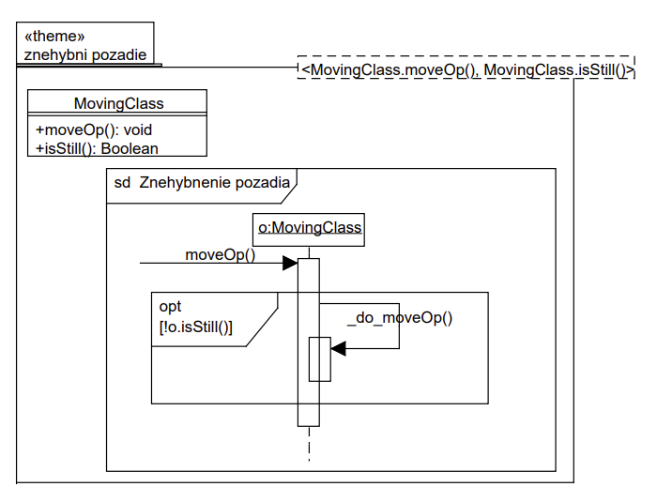
Parametrized
Packages
Source: Aspekty v analýze a návrhu
– prístupy Theme a JPDD Poznámky k
prednáškam z predmetu
Aspektovo-orientovaný vývoja
softvéru, Valentino Vranić, 2017
Launching operation
starts with _do_

Slide 47
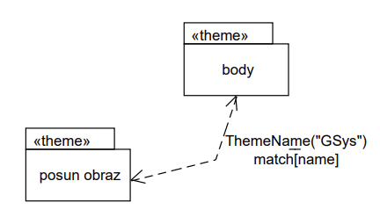
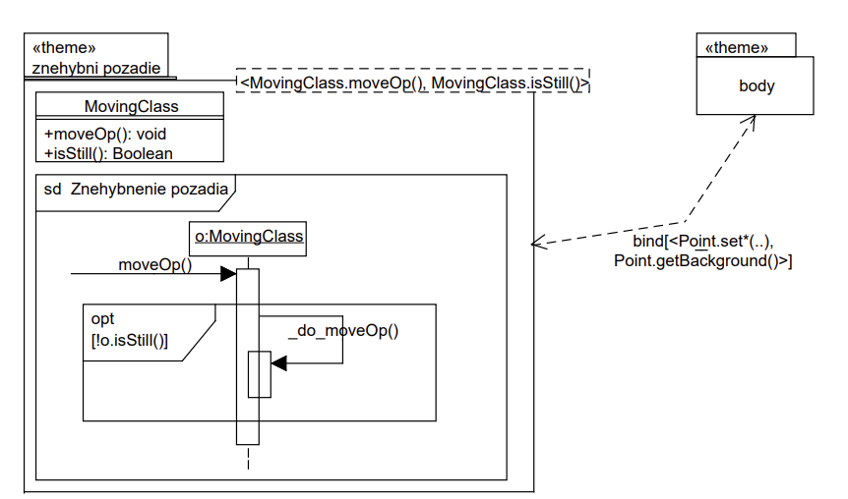
Examples of Composition of Themes
Symmetric
Asymmetric
Source: Aspekty v analýze a návrhu
– prístupy Theme a JPDD Poznámky k
prednáškam z predmetu
Aspektovo-orientovaný vývoja
softvéru, Valentino Vranić, 2017

Slide 48
Examples of Composition of Crosscutting Themes
Source: Aspekty v analýze a návrhu
– prístupy Theme a JPDD Poznámky k
prednáškam z predmetu
Aspektovo-orientovaný vývoja
softvéru, Valentino Vranić, 2017

Slide 49
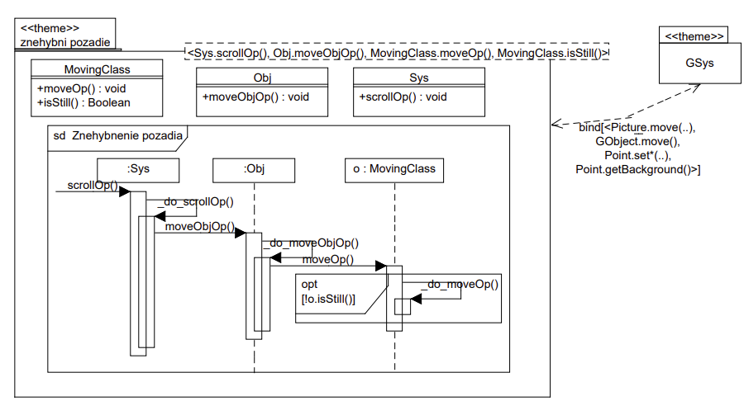
Examples of Composition of Crosscutting Themes
Source: Aspekty v analýze a návrhu
– prístupy Theme a JPDD Poznámky k
prednáškam z predmetu
Aspektovo-orientovaný vývoja
softvéru, Valentino Vranić, 2017

Slide 50
Examples of Composition of Crosscutting Themes

Slide 51
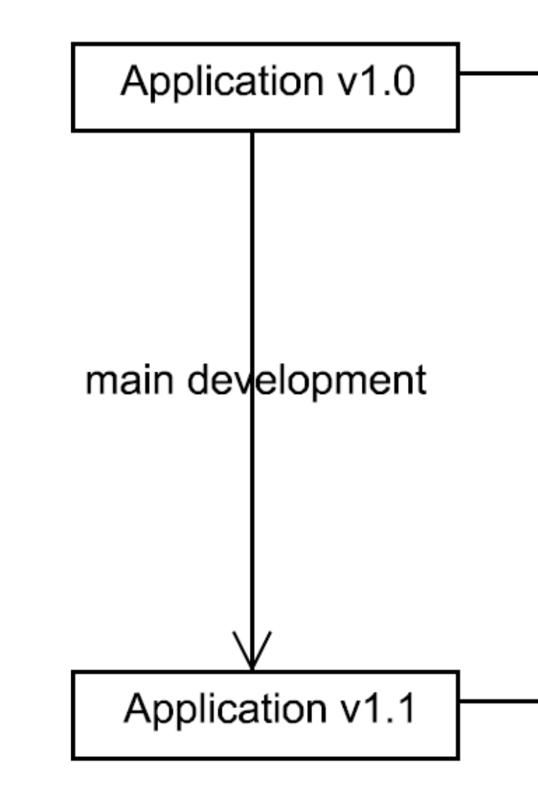
Aspect
Oriented
Change
Realization
Source: Vranić, Valentino. (2010).
Aspect-Oriented Change Realization

Slide 52
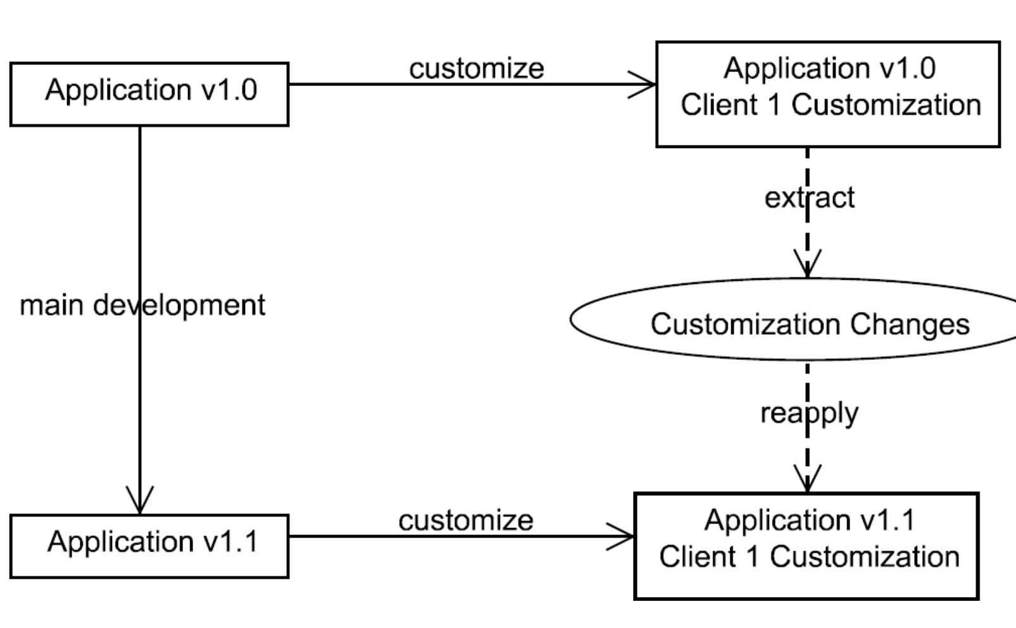
Source: Vranić, Valentino. (2010).
Aspect-Oriented Change Realization

Slide 53
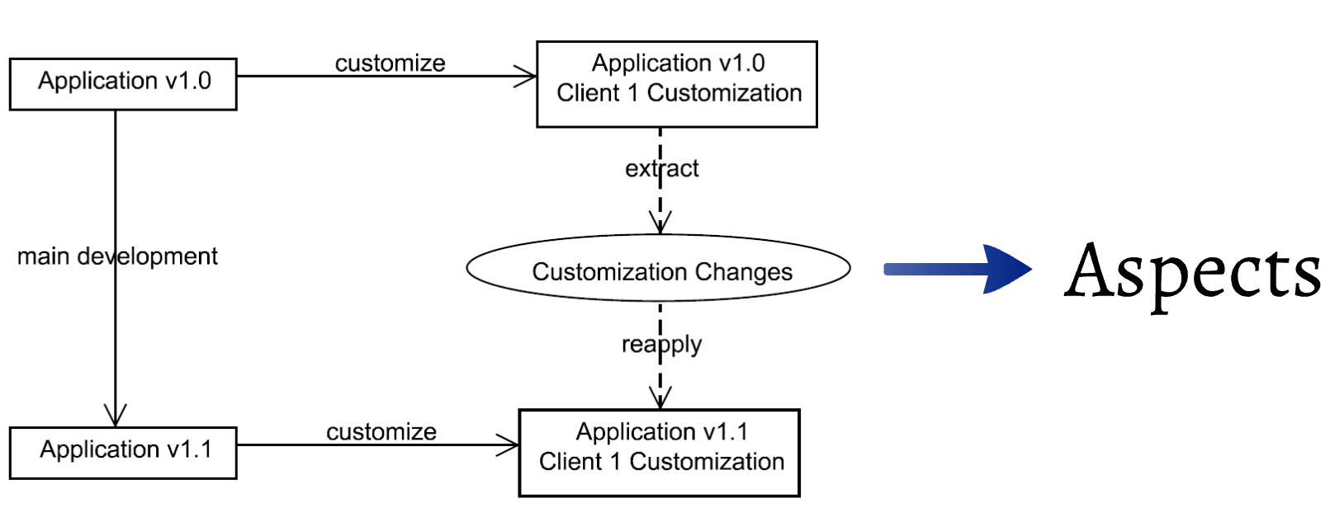
Source: Vranić, Valentino. (2010). Aspect-Oriented Change Realization

Slide 54
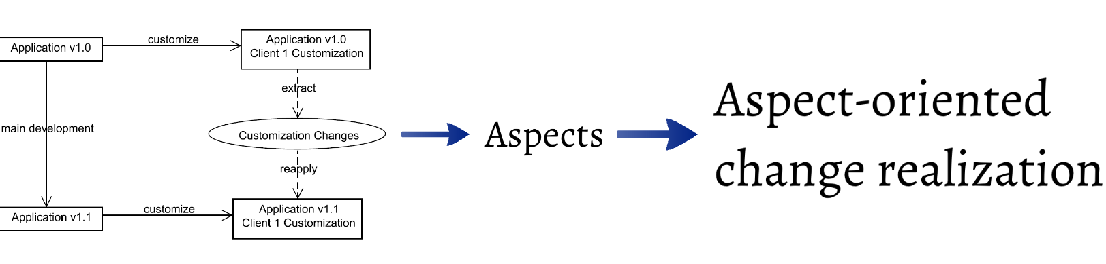
Source: Vranić, Valentino. (2010). Aspect-Oriented Change Realization

Slide 55
Examples From Tests

Slide 56
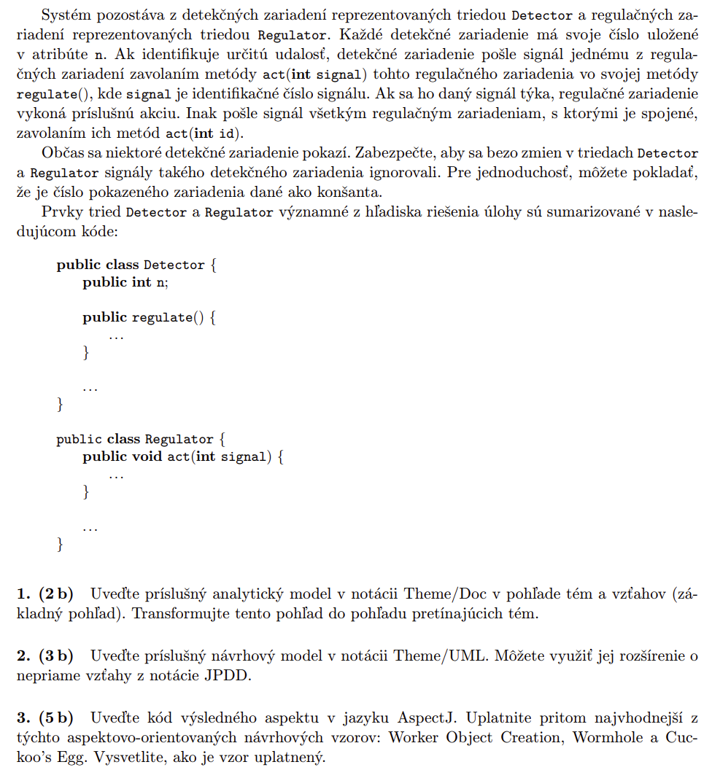
Test
2019
/2020
Source: Valentino Vranić:
https://drive.google.com/drive/folders/1hSmIkd4p2texXMqXPrKjR15ljkIAmMU5

Slide 57
Test
2019
/2020
Requirement
Theme 1
Theme 2 crosscutting
Source: Valentino Vranić:
https://drive.google.com/drive/folders/1hSmIkd4p2texXMqXPrKjR15ljkIAmMU5

Slide 58
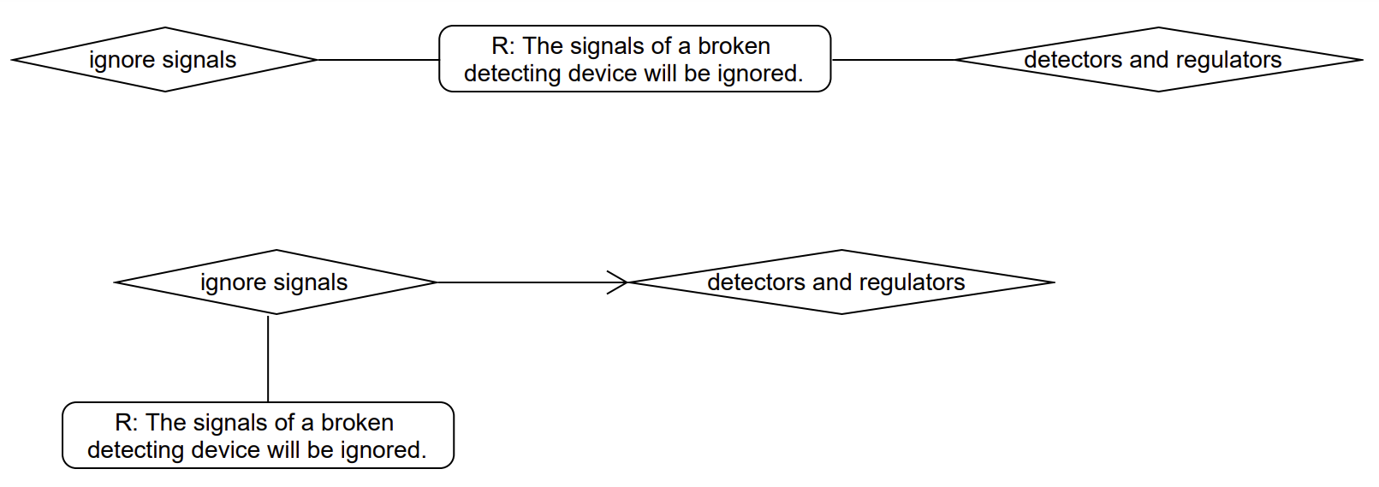
Themes DOC
Source: Valentino Vranić:
https://drive.google.com/drive/folders/1hSmIkd4p2texXMqXPrKjR15ljkIAmMU5

Slide 59
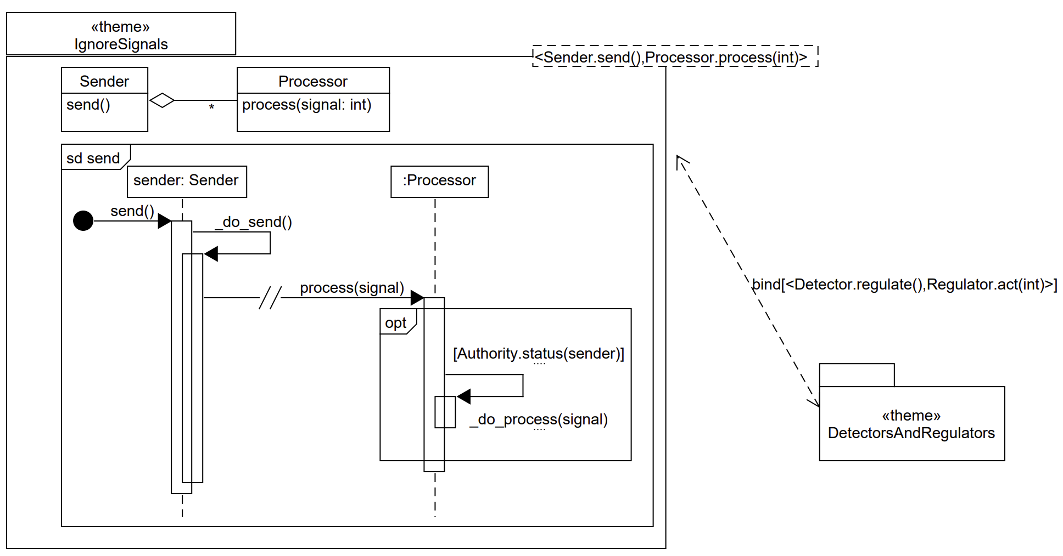
Themes UML
Source: Valentino Vranić:
https://drive.google.com/drive/folders/
1hSmIkd4p2texXMqXPrKjR15ljkIAmMU5

Slide 60
Code
public aspect IgnoreSignals {
pointcut regulations(Detector detector):
execution(void Detector.regulate()) && this(detector); // callee space
pointcut activations(Regulator regulator, int signal):
call(void Regulator.act(int)) && this(regulator) && args(signal); // caller space
pointcut activationsInRegulations(Regulator regulator, int signal, Detector detector):
activations(regulator, signal) && cflow(regulations(detector)) // Wormhole
void around(Regulator regulator, int signal, Detector detector):
activationsInRegulations(regulator, signal, detector)) {
if (Authority.status(detector))
proceed(regulator, signal, detector);
}
}
public class Detector {
public int n;
public regulate() {
...
}
...
}
public class Regulator {
public void act(int signal) {
...
}
...
}
Application of
Wormhole pattern
Source: Valentino Vranić:
https://drive.google.com/drive/folders/1hSmIkd4p2texXMqXPrKjR15ljkIAmMU5

Slide 61
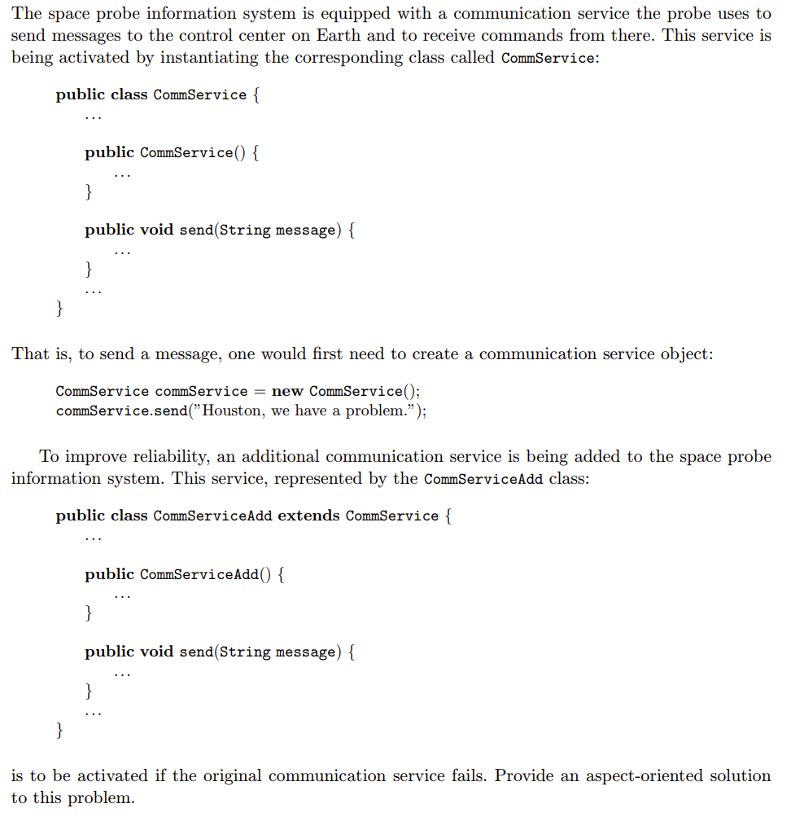
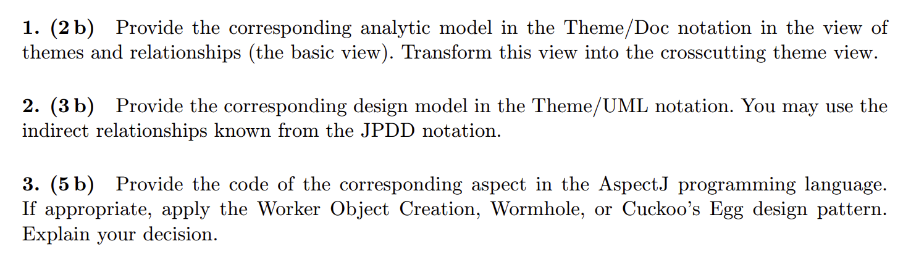
Test
2018
/2019
Source: Valentino Vranić:
https://drive.google.com/drive/folders/
1hSmIkd4p2texXMqXPrKjR15ljkIAmMU5

Slide 62
Test
2018
/2019
Source: Valentino Vranić:
https://drive.google.com/drive/folders/
1hSmIkd4p2texXMqXPrKjR15ljkIAmMU5
Activate CommServiceAdd = Communication service
Theme 1
Theme 2 crosscutting
Problem = requirement

Slide 63
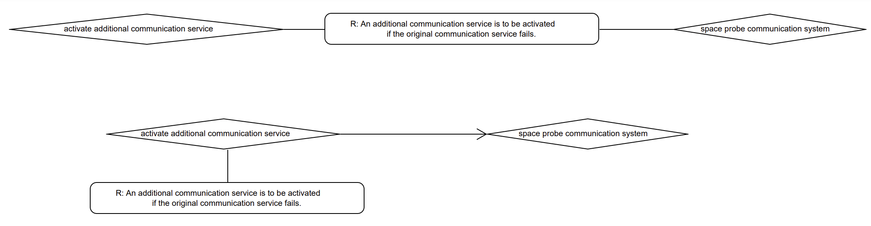
Themes DOC
Source: Valentino Vranić:
https://drive.google.com/drive/folders/1hSmIkd4p2texXMqXPrKjR15ljkIAmMU5

Slide 64
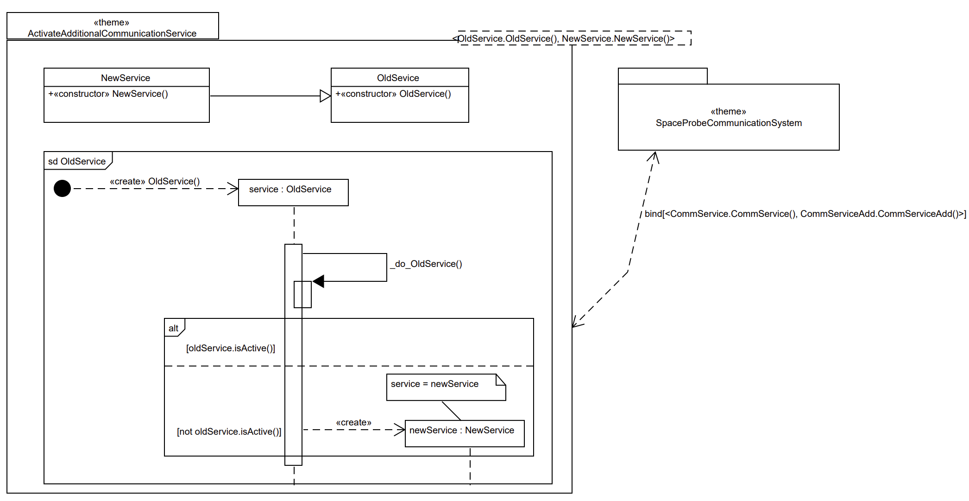
Themes UML
Source: Valentino Vranić:
https://drive.google.com/drive/
folders/1hSmIkd4p2texXMqXPrKjR15ljkIAmMU5

Slide 65
Code
public aspect ActivateAdditionalCommService {
CommService around(): execution(void CommService.new()) {
CommService commService = proceed();
if (commService.isActive())
return commService;
else
return new CommServiceAdd();
}
}
public class CommService {
public CommService() {
}
public void send(String message) {
}
public bool isActive() {
}
}
public class CommServiceAdd extends CommService {
public CommServiceAdd() {
}
public void send(String message) {
}
}
Application of
Cuckoo’s egg pattern
Source: Valentino Vranić:
https://drive.google.com/drive/folders/1hSmIkd4p2texXMqXPrKjR15ljkIAmMU5

Slide 66
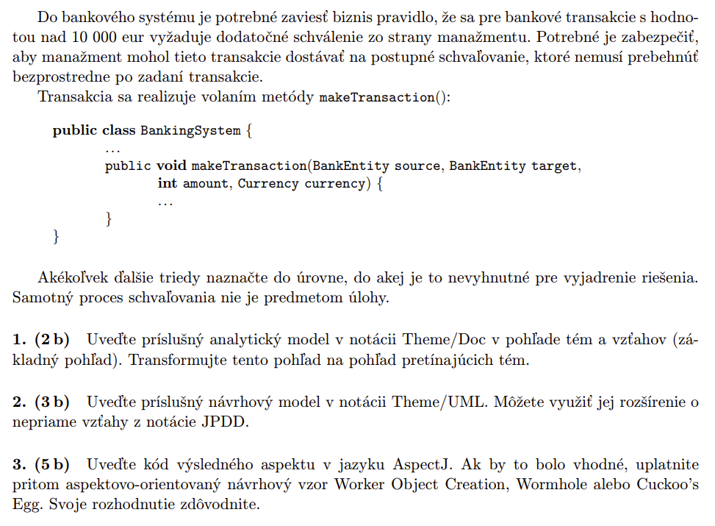
Test
2017
/2018
Source: Valentino Vranić:
https://drive.google.com/
drive/folders/
1hSmIkd4p2texXMqXPr
KjR15ljkIAmMU5

Slide 67
Test
2017
/2018
Theme 1
Theme 2 crosscutting
Source: Valentino Vranić:
https://drive.google.com/
drive/folders/
1hSmIkd4p2texXMqXPr
KjR15ljkIAmMU5

Slide 68
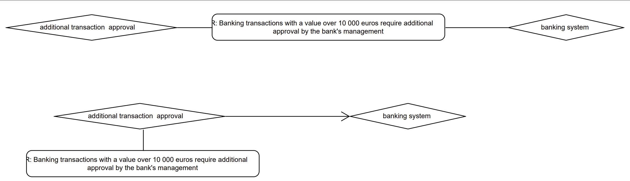
Themes DOC
Source: Valentino Vranić:
https://drive.google.com/drive/folders/1hSmIkd4p2texXMqXPrKjR15ljkIAmMU5

Slide 69
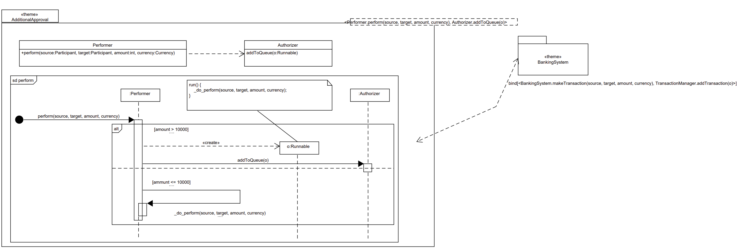
Themes UML
Source: Valentino Vranić:
https://drive.google.com/drive/folders/1hSmIkd4p2texXMqXPrKjR15ljkIAmMU5

Slide 70
Code
public class BankingSystem {
public void makeTransaction(BankEntity source, BankEntity target, int ammount, Currency currency) {
}
}
public class TransactionManager {
public List<Object> transactionsToBeAuthorized;
TransactionManager getTransactionManager() {
}
void addTransaction(transaction) {
}
}
Source: Valentino Vranić:
https://drive.google.com/drive/folders/1hSmIkd4p2texXMqXPrKjR15ljkIAmMU5

Slide 71
public aspect TransactionAdditionalAuthorization {
// other arguments might have been captured, too, so that the authorizer could make a qualified decision
void around(int ammount): call(void BankingSystem.makeTransaction(..)) && args(*, *, ammount, *) {
if (transaction.getAmmount() < 10000)
proceed(ammount);
else {
TransactionManager.getTransactionManager().addTransaction(new Runnable() {
public void run() {
proceed(ammount);
}
});
}
}
}
Application of
Proceed object pattern
Source: Valentino Vranić:
https://drive.google.com/drive/folders/1hSmIkd4p2texXMqXPrKjR15ljkIAmMU5

Slide 72
JPDD
Join Point Designation Diagrams
To determine join points
Graphical notation to expressed join points
Query models in broader sense:
For activity diagrams, state diagrams, structural and sequence diagrams
7V. Stricker, S. Hanenberg, and D. Stein. Designing Design Constriants in
the UML Using Join Point Designation Diagrams.
In Proc. of 47th Int. Conf. on Objects, Components, Models, and Patterns,
TOOLS EUROPE 2009, Zurich Switzerland, June/July 2009, Springer

Slide 73
Lexical Correspondence
Each class that starts on Proc
Each variable with type String
that starts on my
Each variable with name
element of any type
Each method which name is
starting with eval, and with two
arguments, where the first is Integer
called num and second is called custom
of any type, and return type is void
Each method which name is calc, and with two arguments, where the first is Integer called num and second is Double called num2, and return type can be any

Slide 74
Relations Between Classes
As in class diagram
+ optional JPDD relations
The use of indirect operator
Any (number of) other objects can be
inherited from Animal class and still
Tigre class inherits from them
Any other arguments
in any number

Slide 75
Lexical correspondence
Negation:
Each variable except those with type of String
that does not start on my
Each variable that does not start on my
Negation in relations between classes:

Slide 76
Sequence Diagrams
Sending messages
Any flow: any
number of
entities calls
between Animal
and any object
Any entity/actor
Called method starts
with defend and
has any arguments
How to interpret diagram:
Any control flow
Trying to find all such configurations of
sending messages that
correspond to the diagram (this)
Any return type

Slide 77
Parametrization
<?ID>
Inside templates near the name of elements where
they are positioned
Can be used in references inside JPDD
Inside <> parenthesis
Starts with ?
question mark
Parameters are located in bottom part:
List of JPDD parameters
JPDD is bounded
in an ellipse
?ObjektType
?name

Slide 78
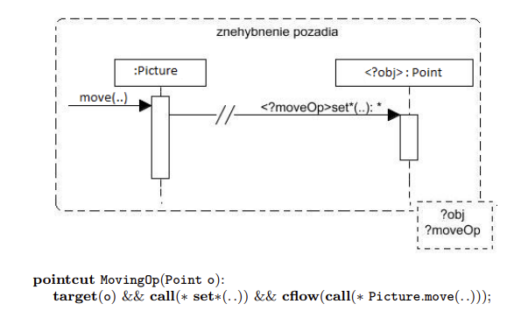
JPDD Examples
Source: Aspekty v analýze a návrhu
– prístupy Theme a JPDD Poznámky k
prednáškam z predmetu
Aspektovo-orientovaný vývoja
softvéru, Valentino Vranić, 2017

Slide 79
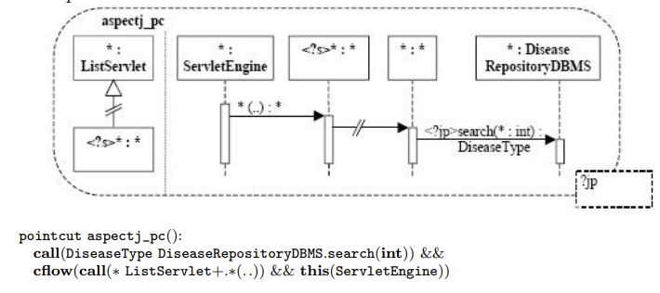
JPDD Examples
Source: Aspekty v analýze a návrhu
– prístupy Theme a JPDD Poznámky k prednáškam z predmetu Aspektovo-orientovaný vývoja softvéru, Valentino Vranić, 2017

Slide 80
Resources
Application of Themes approach: Bc. Pavol Michalco: PRÍPADY POUŽITIA A TÉMY V PRÍSTUPE THEME/DOC
D. Stein. Join Point Designation Diagrams: A Visual Design Notation for Join Point Selections in Aspect-Oriented Software Development. PhD. thesis, Universität Duisburg-Essen, 2010.
E. Baniassad and S. Clarke, "Theme: an approach for aspect-oriented analysis and design," Proceedings. 26th International Conference on Software Engineering, Edinburgh, UK, 2004, pp. 158-167, doi: 10.1109/ICSE.2004.1317438.
AMPLE Project home page (Aspect-Oriented, Model-Driven Product Line Engineering: Web page Rashid, A., Royer, J.C., Rummler, A. (eds.): Aspect-Oriented, Model-Driven Software Product Lines: The AMPLE Way (09 2011)
Aspect-Oriented Change Realization Based on Multi-Paradigm Design with Feature Modeling Article Radoslav Menkyna and Valentino Vranić. Aspect-Oriented Change Realization Based on Multi-Paradigm Design with Feature Modeling
. In Proceedings of 4th IFIP TC2 Central and East European Conference on Software Engineering Techniques, CEE-SET 2009, Revised Selected Papers, LNCS 7054, October 2009, Krakow, Poland, Springer, 2012.
Aspect-Oriented Change Realizations and Their Interaction Article V. Vranić, R. Menkyna, M. Bebjak, and P. Dolog. Aspect-Oriented Change Realizations and Their Interaction. e-Informatica Software Engineering Journal, 3(1):43-58, 2009
Pointcut Language in AspectJ For Analogies: The AspectJ in Action Laddad, Ramnivas, 2003. AspectJ in action: practical aspect-oriented programming. Greenwich, CT: Manning. ISBN 978-1-930110-93-9.
Perdek, Jakub, and Valentino, Vranić. "Lightweight Aspect-Oriented Software Product Lines with Automated Product Derivation." In New Trends in Database and Information Systems (pp. 499–510). Springer Nature Switzerland, 2023.
D. Stein, S. Hanenberg, and R. Unland. Query Models. In Proceedings of 7th International Conference on the Unified Modeling Language (UML 2004) – The Language and Its Applications, Lisbon, Portugal, October 2004, LNCS 3273, Springer.

